Slide 1

Soccer Match Result Prediction
Group 17
Abdul Rahman Khan
Anmol Panna
Levi Gopinath Nair
Sharang A

Slide 2

Purpose
To predict the result of a soccer match between the home team and the away team using historical data with the help of AI

Slide 3
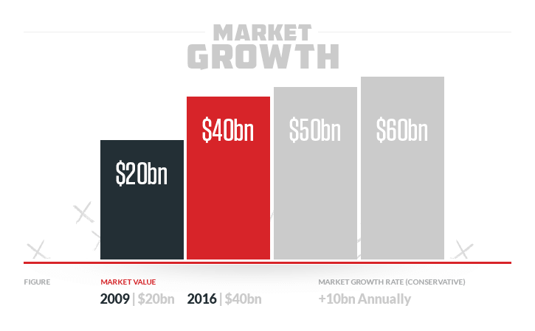
Betting Industry
https://www.sportsbettingdime.com/guides/finance/global-sports-betting-market/

Slide 4
Description
Sports betting has been growing exponentially over the years. People bet huge amount of money on live matches. But due to the unpredictable nature of the game, it is hard to decide which team to bet on.
Our machine learning model aims at finding out whether a structure of Random Forrest, KNN, SVM, Naïve Bayes, XG Boost and AdaBoost and other algorithms can accurately predict the outcome of a football game
For assisting our target audience who want to maximize their investment with the least amount of risk involved.
We intend to make a machine learning model that can use the data of the previous matches and predict the outcome of the game.

Slide 5
Objectives
Collect and Clean Data
Analyze the Data
Visualize the Data
Model Selection
Prediction and Protoyping
Deployment

Slide 6
Architecture Diagram
Import packages
Data Analysis & Data Visualization
Data Preprocessing
Model Evaluation
Understanding the co-relation and patterns in the data.
Removed Outliers
Label Encoder
Robust Scaler
Train Test Split
Predicting Outcomes
Training/Testing
Algorithm Selection
Model Refinement
Win, Loss or Draw?
Optimizing the model

Slide 7
Collect and Clean Data
The first step is to collect data and understand our needs and preprocess accordingly. We collected data from Records of EPL matches held from the year 2000 to 2019.

Slide 8
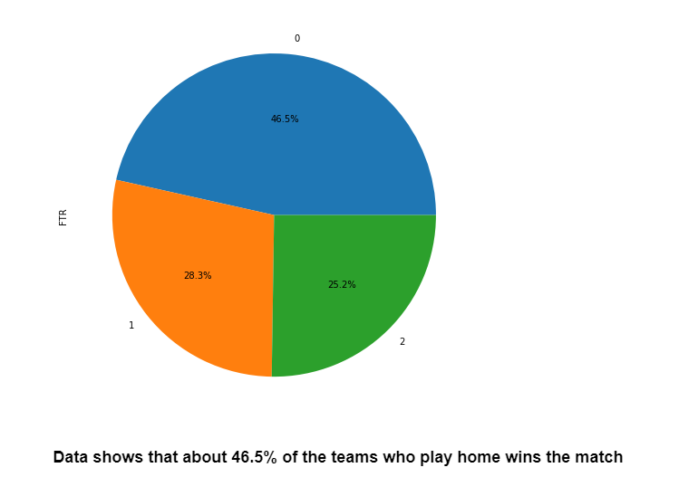
Analysis of data

Slide 9
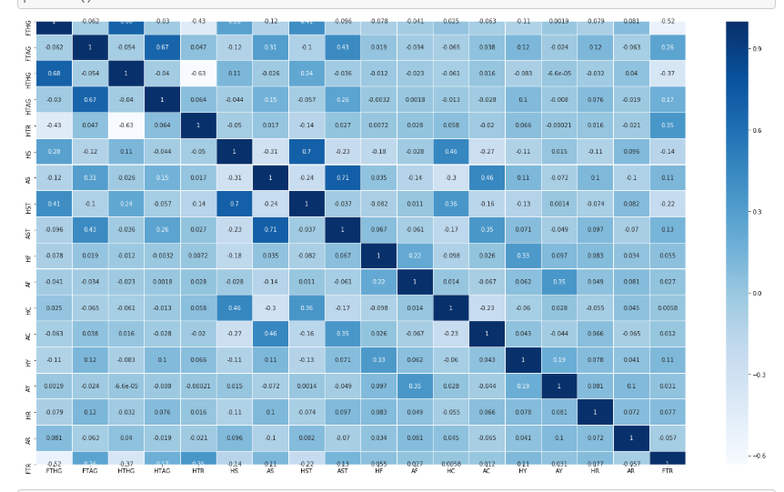
Co-relation with features

Slide 10
Constraints
Form and morale of the team affects the game which cannot be predicted
Weather condition of the stadium also affects the game
Injury to key players can shift the momentum of the game

Slide 11
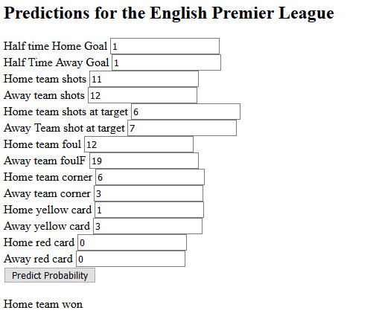
API

Slide 12
What more can be done?
Predict the score of the match
01
Make predictions based on team’s current form
02
Increase the accuracy of the model
03

Slide 13
Demo

